Slide 1


SAP UI5 & FIORI with OData TRAINING using BAS
Anubhav Oberoy
Day – 12

Slide 2

Agenda – Day 12
Drill Down using the Table
Messages in UI5
Drop Down
Object Status
Fragments
Different Ways of loading fragment
Value Help Popup

Slide 3
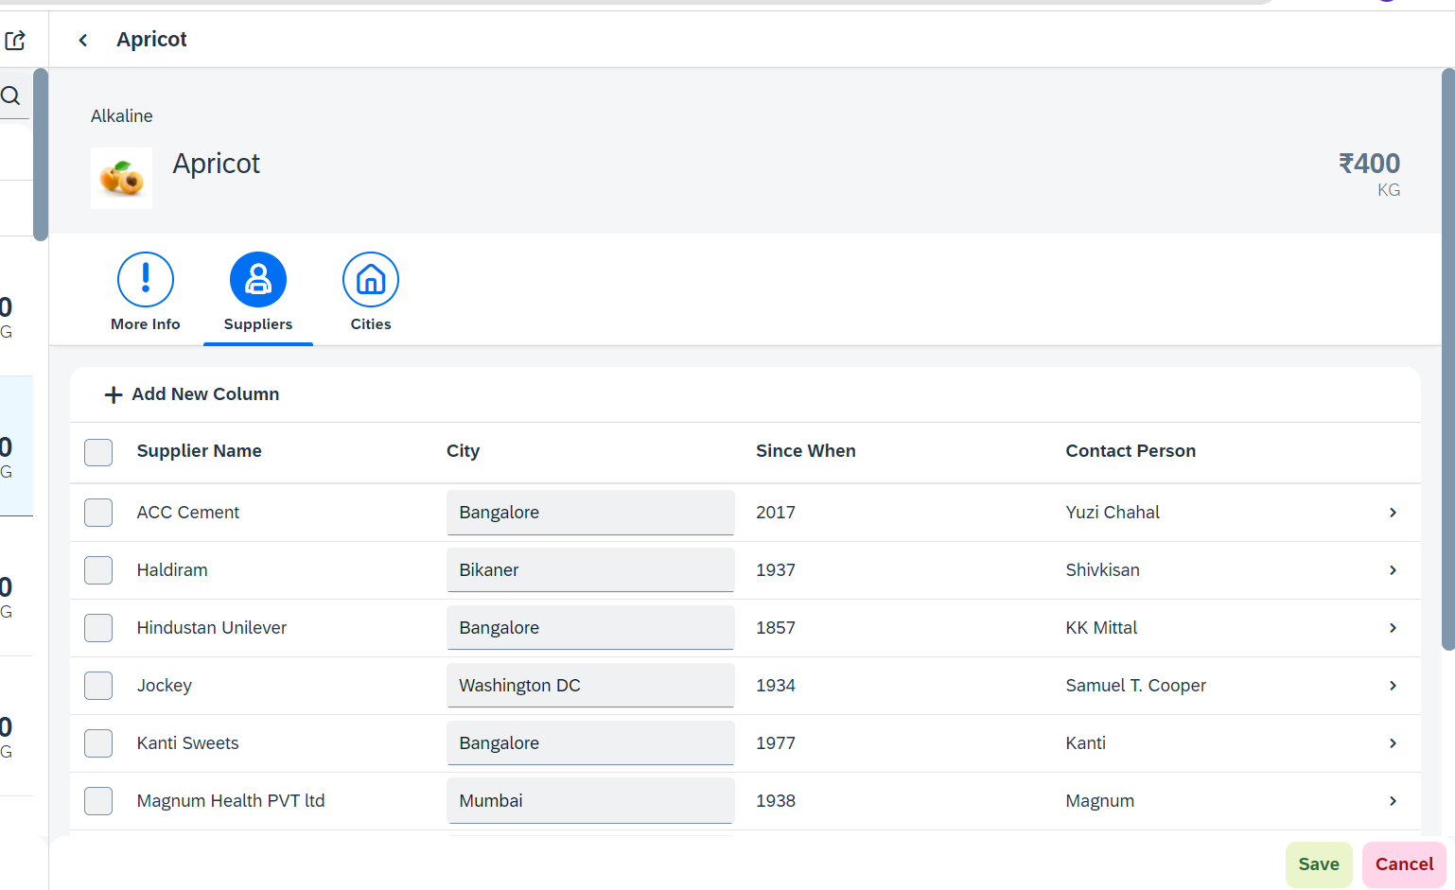
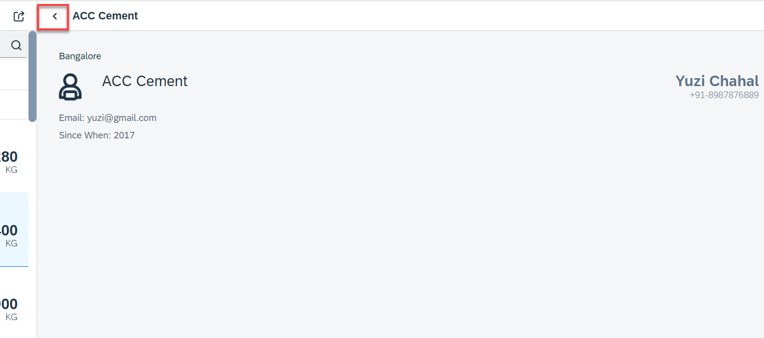
Hands – on: Drill Down from Table and Nav Back
Now we drill down to a new screen where we will show the supplier data for that we will create a new supplier view.
Along with that we will also add the back button login to go back using a nav button on the supplier view.
Code Link:-
View2.controller.js
Supplier.view.xml
Supplier.controller.js
BaseController.js
manifest.js
The nav back logic is written in BaseController so that it can be used at multiple places.

Slide 4
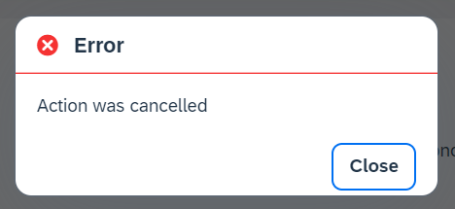
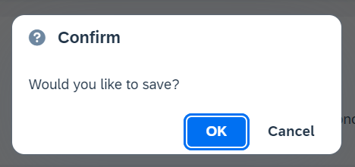
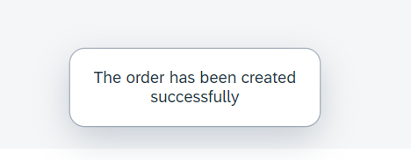
Messages in UI5
The system generates messages in response to what users do in the SAP system. A message presents information, an instruction, or a warning to users in a given situation.
Messages can be used to notify the user about specific states of the application and can help the user to correct their incorrect inputs.
For showing messages to the user that are related to the current page, you have several possible controls. Each of these offers a different type of interaction from the user. Choose the control that fits best in you interaction pattern.
Message Dialog: A message dialog interrupts the user's workflow by blocking the current page and needs to be closed by the user.
Message Toast: A message toast is an overlay that disappears after some time or if the user taps somewhere else. It does not block the user.
Message Box of type error
Message Box of type Confirm
Message Toast

Slide 5
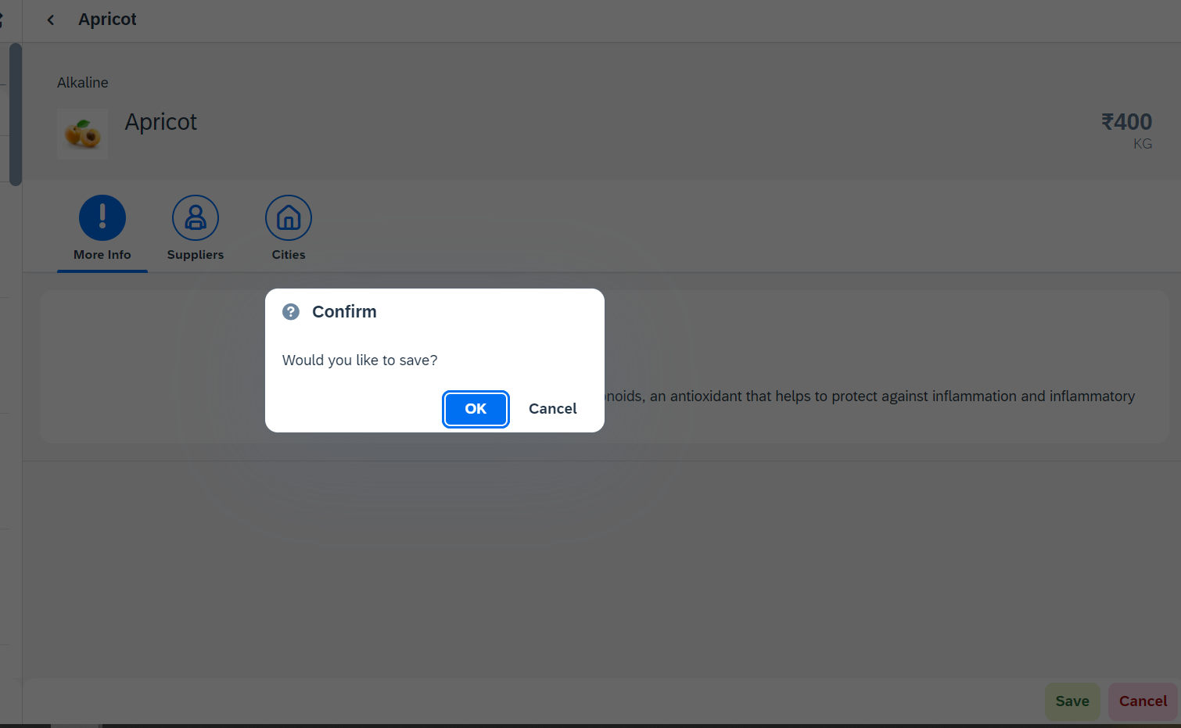
Hands – on: Messages
Now we will see how to use the messages in the ui to get users conformation or to show error to the use.
For this we will see the example of Message Box and Message Toast.
Code Link: -
View2.view.xml
View2.controller.js

Slide 6
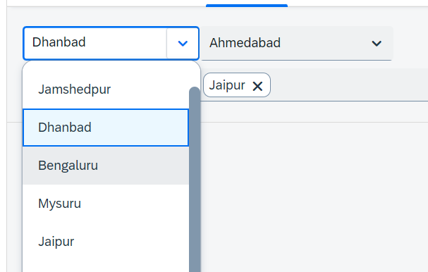
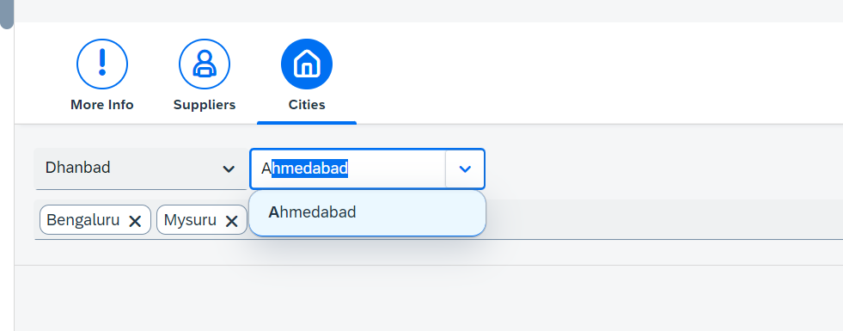
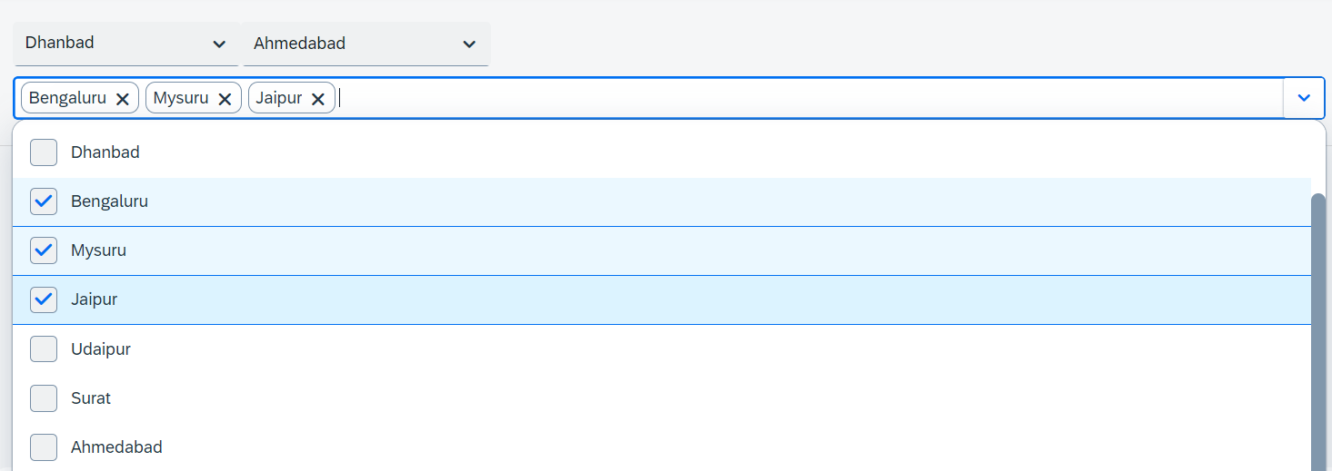
Hands – on: Drop Down Controls
Now we will see the example of some Drop Down Controls present in UI5.
We will load the cities data in the different types of drop downs to see their functioning.
Code Link:-
View2.view.xml

Slide 7
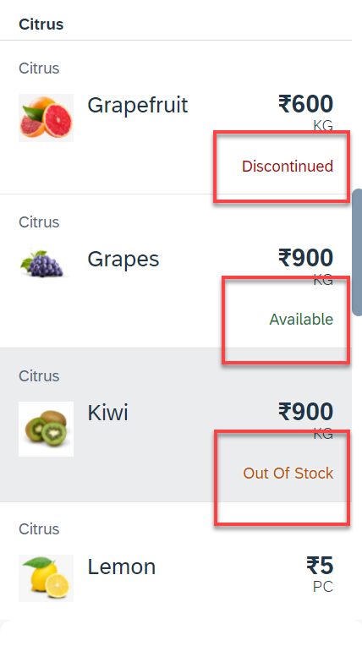
Hands – on: Object Status
Some time we want to show the status any item in different colors, as in our case we want to show the availability of a fruit in different colors like Available, Out of Stock, Discontinued.
For this we will add the object status attribute in the Object list item in View1.
Code Link:-
View1.view.xml
View1.controller.js
formatter.js

Slide 8
Fragments
Fragments are light-weight UI parts. They are used to modularize views. We can reuse a fragment multiple times in same view or other views.
Fragments are used similar as sap.ui.core.mvc.Views, but Fragments do not have their own controllers. Logic related to fragment’s UI elements is written in the host view’s controller.
Fragments are like parasite, they rely on the controllers of the host views.
There are 2 techniques to create and work with fragments
Direct embedding using fragment
Use JS class sap/ui/core/Fragment and use load function to load it
View1
Controller1
Address – street, house, city, country
fragment
B
Event for fragment button
fragment
B
View 2
Controller2
fragment
Event for fragment button
B

Slide 9
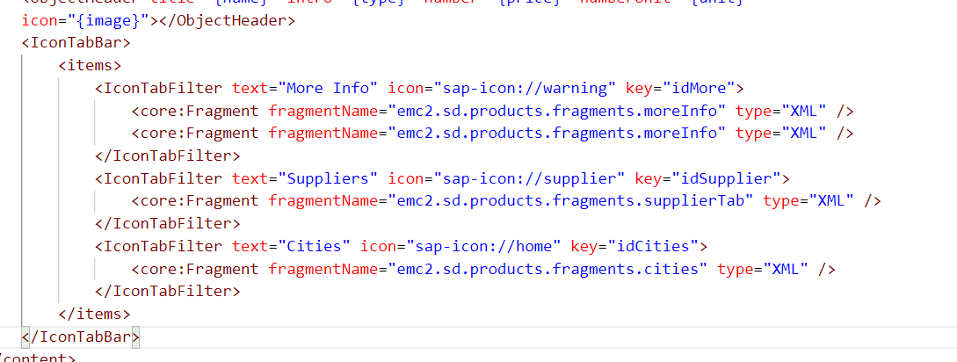
Hands – on: Embedding Fragment in View
For this hands – on we have to create a folder named fragments in the webapp folder and in that folder create fragment files with the extension .fragment.xml.
We will move the Icon Tab bar code to the fragments and will embed them in the View2 to modularize the code of View2.
Create three file in the fragments folder for more Info Section, Supplier Table section and Cities Section.
To including the fragment directly into the XML View use the sap.ui.core.Fragment class as shown below
Ex: <core:Fragment fragmentName=“namespace.fragments.fragmentName" type="XML" />
Code Links:-
View2.view.xml
moreInfo.fragment.xml
cities.fragment.xml
supplierTab.fragment.xml

Slide 10
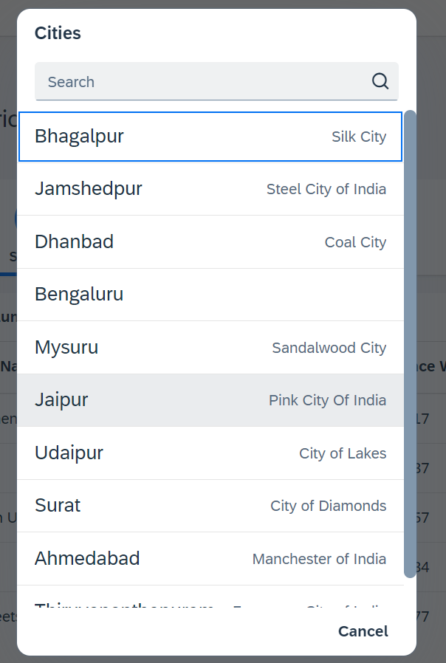
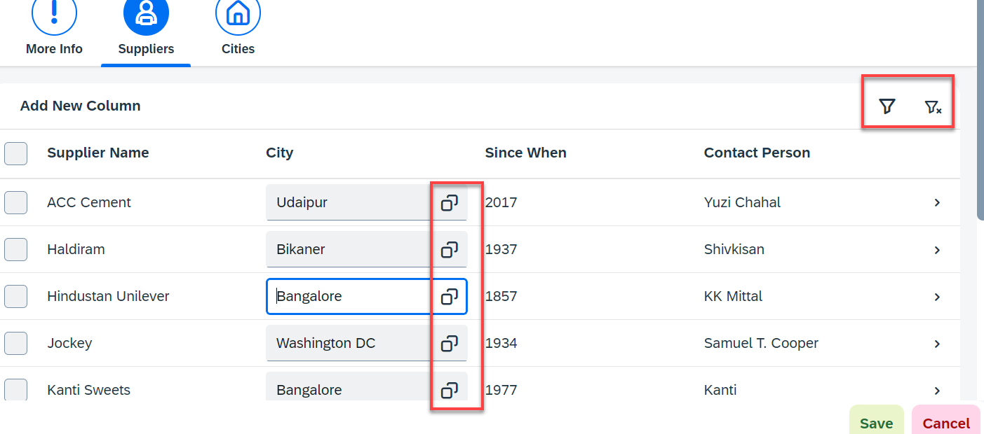
Hands – on: Fragment Use Case 2 (Using JS Code)
My manager asked me to develop following requirements
Add a filter button in the toolbar of the table, and when we click filter icon, it should load a popup with all the list of suppliers. When we select supplier inside filter it should filter data in the table.
Inside the table we have a city field. We would like to enable a value help (F4 Help), when we click on same, it should open a popup which shows all the list of cities on screen.
Part 1: Opening filter popup using the Filter Button.
popup.fragment.xml
supplierTab.fragment.xml
View2.controller.js
Part 2: Opening the Value help popup in the Supplier Table
popup.fragment.xml
supplierTab.fragment.xml
View2.controller.js

Slide 11

End of Day 12

Slide 12

Questions

Slide 13

Anubhav Oberoy

Slide 14


We’re committed to empower you to be
Most Desirable Resource
through powerful training solutions.
We build the workforce of the future.
250+
Corporate Clients
30,000+
Learners Trained
25000+
Learners Placed
FREE WEBINARS
Sign up for free webinars with industry experts every fortnight!
Enroll Now!
Contact us today!
https://anubhavtrainings.com/

Slide 15




More from AnubhavTrainings.com

Slide 16
Title
Content

